Slide 1
Tomographic reconstruction from projections with unknown view angles
Arunabh Ghosh

Slide 2
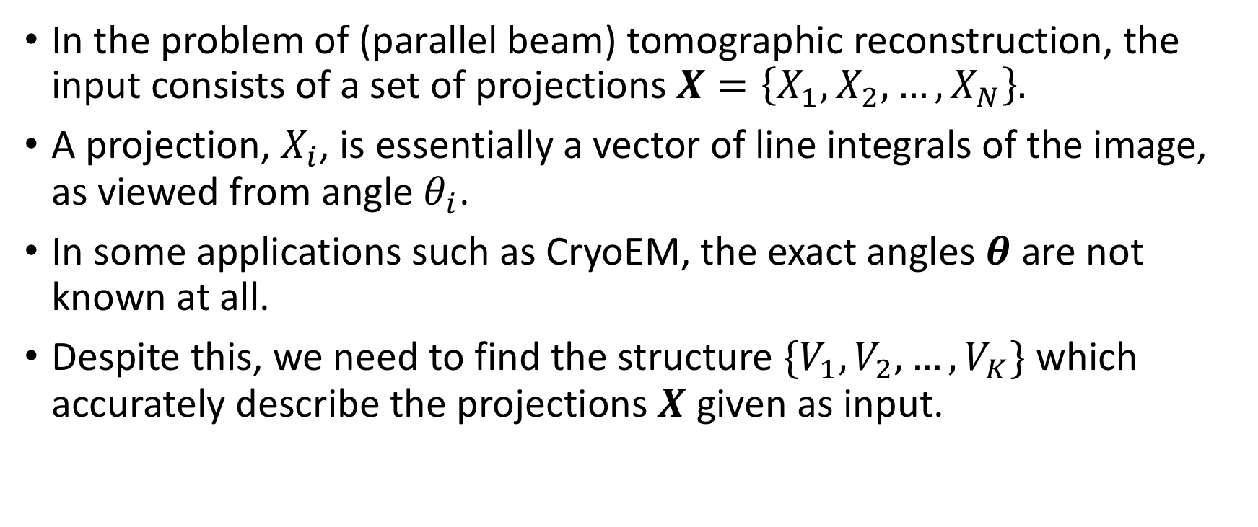
Introduction
In the problem of (parallel beam) tomographic reconstruction, the input consists of a set of projections $X=\left\{X_{1}, X_{2},…,X_{N}\right\}.$
A projection, $X_{i}$, is essentially a vector of line integrals of the image, as viewed from angle $θ_{i}$.
In some applications such as CryoEM, the exact angles $θ$ are not known at all.
Despite this, we need to find the structure ${\{V}_{1},V_{2},…, V_{K}\}$ which accurately describe the projections $X$ given as input.

Slide 3
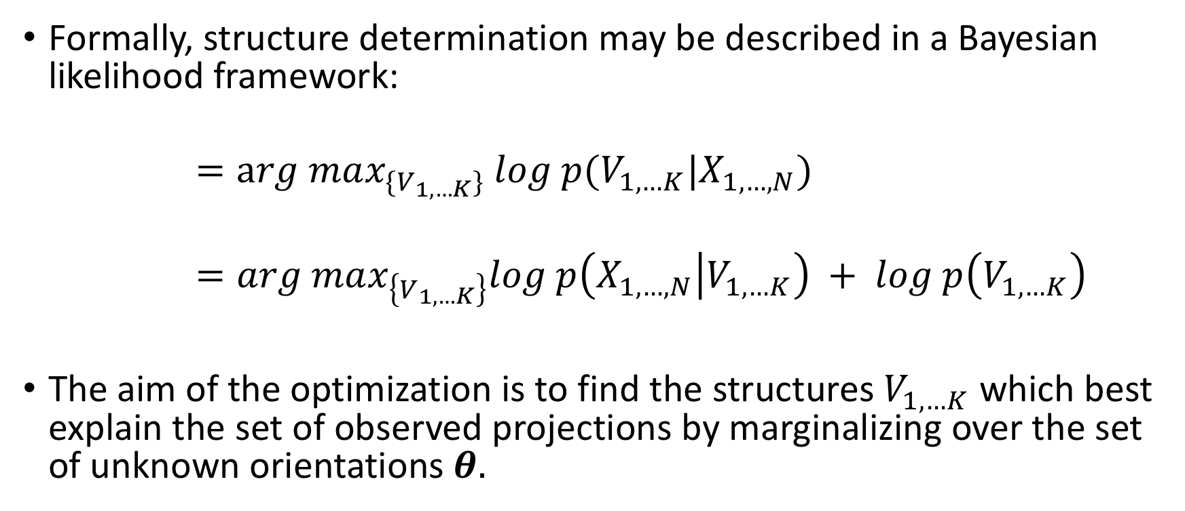
Optimization framework
Formally, structure determination may be described in a Bayesian likelihood framework:
$$=arg max_{\{V_{1,…K}\}} log p(V_{1,…K}|X_{1,…,N})$$
$$=arg max_{\left\{V_{1,…K}\right\}}log p\left(X_{1,…,N} | V_{1,…K}\right) + log p\left(V_{1,…K}\right)$$
The aim of the optimization is to find the structures $V_{1,…K}$ which best explain the set of observed projections by marginalizing over the set of unknown orientations $θ.$

Slide 4
Optimization strategy
Identifying the structures from the projections in unknown directions is a nonconvex optimization problem. Sensitivity to local optima yields inaccurate structure estimates.
Recently, however, methods have been discovered that perform well on nonconvex problems. One such method is Stochastic Gradient Descent (SGD).
Stochastic gradient descent (SGD) algorithm enables ab initio structure determination through insensitivity to initialization.

Slide 5

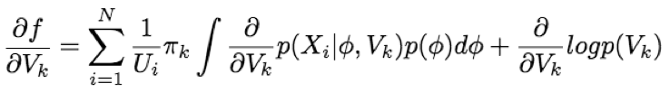
Stochastic gradient descent - Mathematics
Here is the objective function we want to optimize -
SGD optimizes the objective function by taking steps proportional to the gradient of the objective function

Slide 6
Stochastic gradient descent - Mathematics
In SGD, the gradient is approximated using subsampling.
These approximate gradients do not exactly match the overall optimization objective.
The success of SGD is commonly explained by the noisy sampling approximation allowing the algorithm to widely explore the space before finally arrive near the correct structure.
The approximate gradient is (M projections randomly chosen):

Slide 7
Results
The approximate gradient points in a direction within the space that will, in expectation over random selections of minibatches, improve the objective function.
Even though optimization of nonconvex problems is difficult, we find that in practice SGD performs quite well.
In the next section, I’ll show how an SGD algorithm can accurately estimate the structure with completely unknown orientations and no initial estimate.

Slide 8
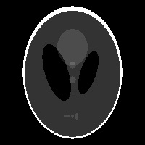
Experiment
Original structure – Shepp-Logan Phantom
Number of projections – 180
Noise in the projections – Gaussian noise with variance 5 percent of the average value of the projections

Slide 9
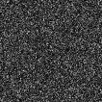
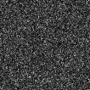
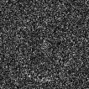
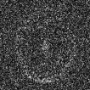
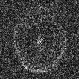
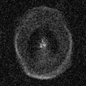

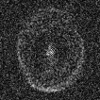
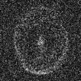
As the iterations progressed…

Slide 10
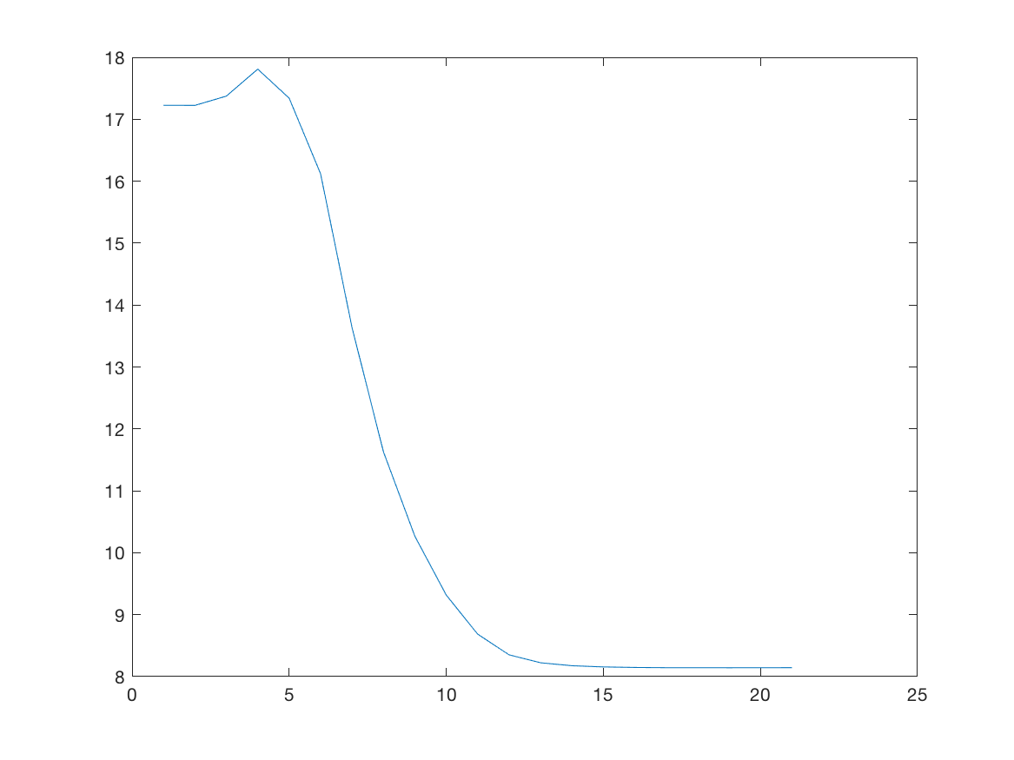
And the final result!
The final reconstructed image
The error as the iterations progressed

Slide 11
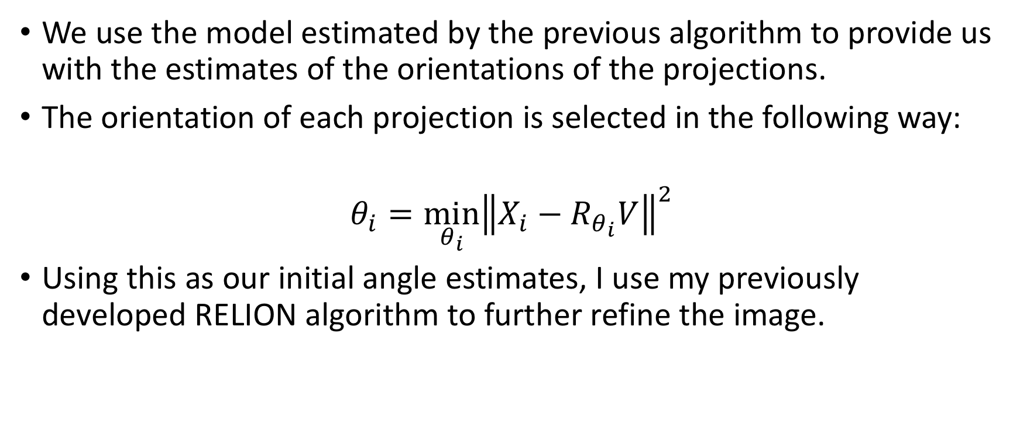
Refinement of the result using RELION
We use the model estimated by the previous algorithm to provide us with the estimates of the orientations of the projections.
The orientation of each projection is selected in the following way:
$$θ_{i}=\min_{θ_{i}}{{\left\|X_{i}−R_{θ_{i}}V\right\|}^{2} }$$
Using this as our initial angle estimates, I use my previously developed RELION algorithm to further refine the image.

Slide 12
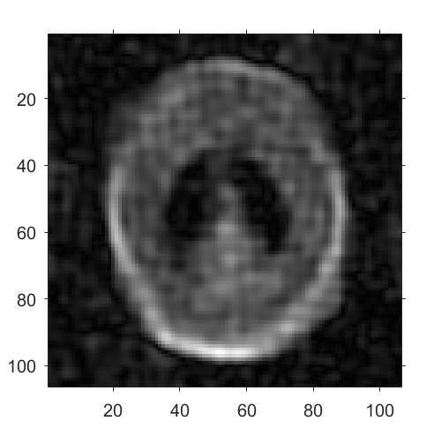
Low-pass filter the initial estimate
A initial estimate of the image is passed through an initial estimate for a smoothing effect and the higher order frequency terms can’t much influence the results.
The initial estimate:

Slide 13
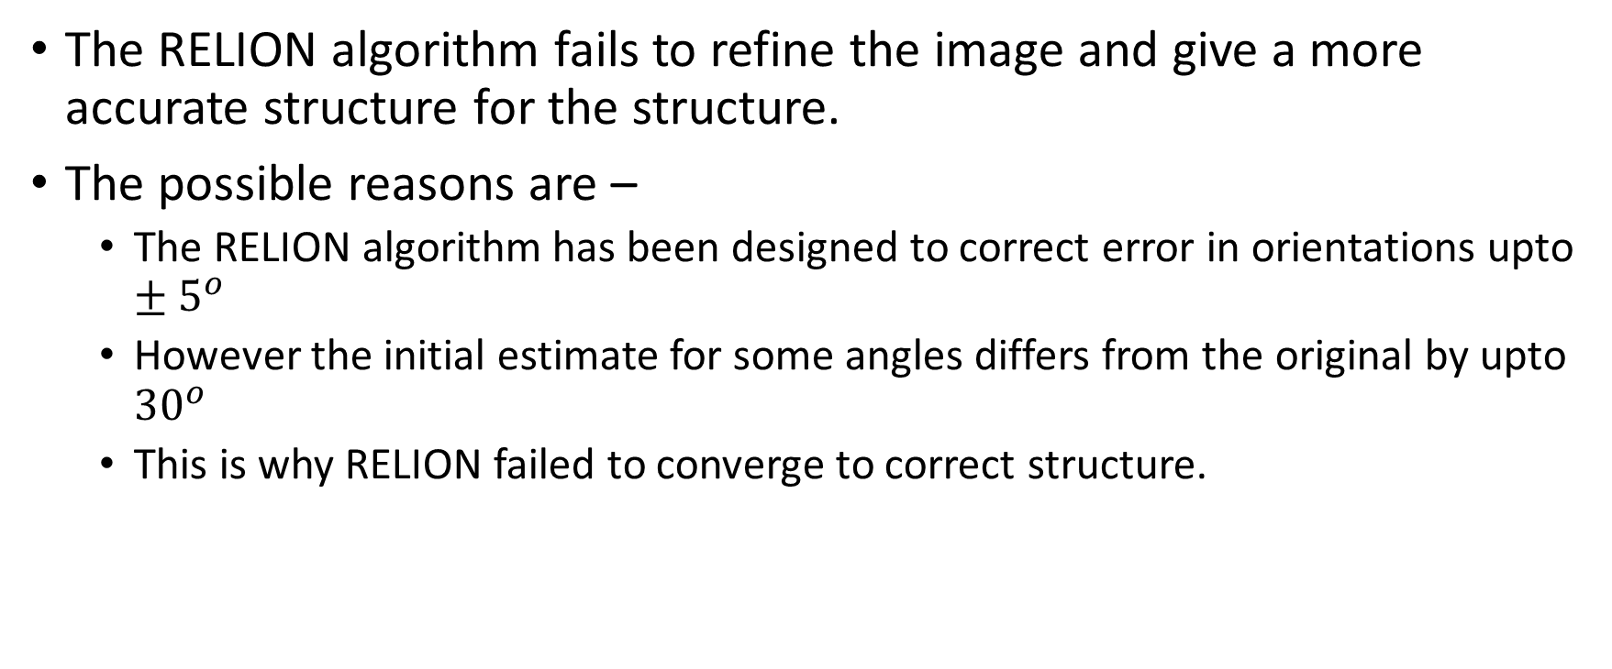
However…
The RELION algorithm fails to refine the image and give a more accurate structure for the structure.
The possible reasons are –
The RELION algorithm has been designed to correct error in orientations upto $±5^{o}$
However the initial estimate for some angles differs from the original by upto ${30}^{o}$
This is why RELION failed to converge to correct structure.

Slide 14
How CryoSPARC deals with this?
CryoSPARC knows that the initial estimate in the orientation may not be close to the actual estimate at all.
So CryoSPARC, in its refinement algorithm – Branch and bound algorithm, considers each orientation for each projection. It does not assume that the that the actual orientation may be close to the estimated orientation.
At the start it considers what is the best orientation for each projection by comparing only the frequency terms. This leads to save in computational time. Gradually it starts considering higher order frequency terms.

Slide 15
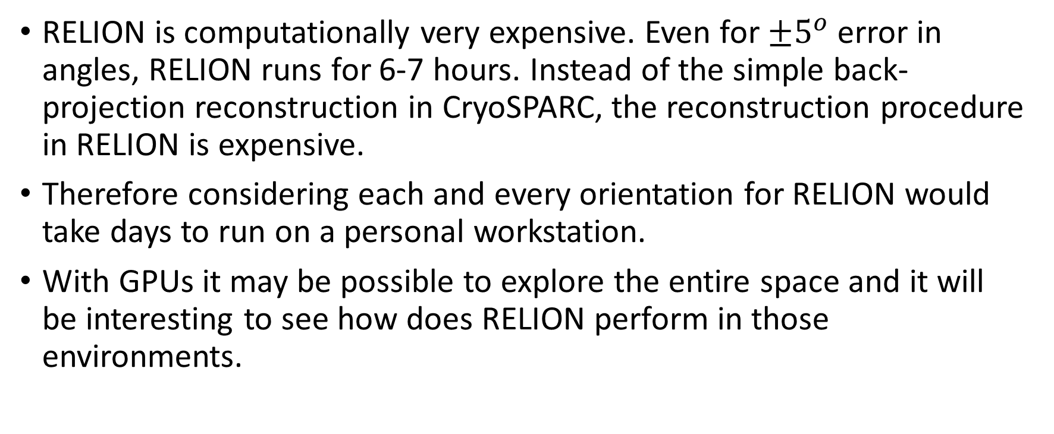
Why can’t RELION do this?
RELION is computationally very expensive. Even for $±5^{o}$ error in angles, RELION runs for 6-7 hours. Instead of the simple back-projection reconstruction in CryoSPARC, the reconstruction procedure in RELION is expensive.
Therefore considering each and every orientation for RELION would take days to run on a personal workstation.
With GPUs it may be possible to explore the entire space and it will be interesting to see how does RELION perform in those environments.

Slide 16
Thank you!
Professor Victor M. Panaretos

